Slide 1
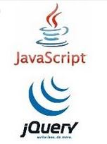
JavaScript and jQuery Course
Session 08 DOM

Slide 2
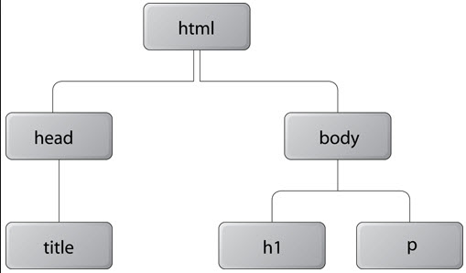
DOM
DOM – hierarchical tree representation of document
- collection of nodes that represent the web page - JavaScript can modify the DOM
descendants
parents
children
siblings
nodes

Slide 3
DOM – commonly used node types
document | Only has element nodes as child node
element | Can have element, text, comment node as a child node
attr | Attribute of an element Can have text node as a child node
text | Text for an element, attribute, comment No child nodes

Slide 4
Node Properties
nodeValue | Returns the text for a text, attribute, comment node
parentNode | Returns the parent of that node
childNodes | Returns an array of node objects
firstChild | Returns a node object for the first child node
lastChild | Returns a node object for the last child node
nextElementSibling | Returns node object for next sibling
If no node exists, returns null

Slide 5
Methods of document interface
getElementById(id) returns the element object that matches the id
getElementsByTagName(tag_name) returns an array of elements that matches the tag_name value
<input name="fname" id="fname" type="text"> <input name="lname" id="lname" type="text">
Elements
= plural
all <input> elements

Slide 6
Methods of document interface
getElementsByTagName(tag_name) returns an array of elements that matches the tag_name value
<input name="fname" id="fname" type="text"> <input name="lname" id="lname" type="text">
// clear out text box values
for (var i = 0; i < document.getElementsByTagName('input').length; i++) {
document.getElementsByTagName('input')[i].value = " ";
}
array

Slide 7
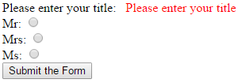
Methods of document interface
getElementsByName(name_value) returns an array of elements that matches the name_value value
<input name="title" type="radio" id="Mr" value="Mr"> <input name="title" type="radio" id="Mrs" value="Mrs"> <input name="title" type="radio" id="Ms" value="Ms">
Elements
= plural
all elements with name attribute
–used by the web server

Slide 8
Methods of document interface
getElementsByName(name_value) returns an array of elements that matches the name_value value
// determine if any title was checked
for (var i = 0; i < document.getElementsByName('title').length; i++) {
if (document.getElementsByName('title')[i].checked) { titleOK = true; }
}
array

Slide 9
Methods of document interface
getElementsByClassName(class_name) returns an array of elements that matches the class_name value
<span class="err">Please enter…</span>
Elements
= plural
all elements that have a class of err

Slide 10
Methods of document interface
getElementsByClassName(class_name) returns an array of elements that matches the class_name value
<span class="err"> </span>
// clear out error messages
for (var i = 0; i < document.getElementsByClassName('err').length; i++){
document.getElementsByClassName('err')[i].firstChild.nodeValue = "";
}
array

Slide 11
Property of document interface
document.getElementById("“).nextElementSibling returns an object for the next element sibling, or returns null if it does not exist
<input type="text" id="fname" name="fname"> <span class="err"> </span>
// display error message without using an id
if(document.getElementById('fname') == "") {
document.getElementById('fname').nextElementSibling. firstChild.nodeValue = “Please enter your first name";
}

Slide 12
Methods of element interface
hasAttribute(attribute_name) returns true if the element has the attribute specified in attribute_name
<span class="red">Dogs</span>
this element has an attribute – class

Slide 13
Methods of element interface
getAttribute(attribute_name) returns the value of the attribute specified in attribute_name
<span class="red">Dogs</span>
this attribute value is red

Slide 14
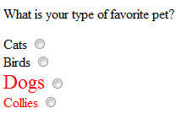
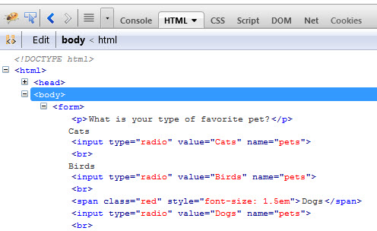
Methods of element interface
setAttribute(attribute_name, value) sets the attribute to the value, or sets a new attribute
<span class="red">Dogs</span>

Slide 15
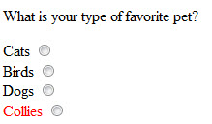
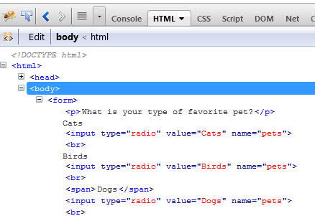

Methods of element interface
removeAttribute(attribute_name) removes the attribute
<span class="red">Dogs</span>

Slide 16
Methods of document interface - not in text querySelector(), querySelectorAll()
// Access the first .myClass class name
document.querySelector('.myClass');
// Return a NodeList of all instances of .myClass
document.querySelectorAll('.myClass');
// Accessb the myID id
document.querySelector('#myID');
// Return a NodeList of all 'div' instances
document.querySelectorAll('div');
//Access the last list Node of .someList unordered list
document.querySelector('ul.someList li:last-child');

Slide 17

Methods of document interface - not in text querySelectorAll()
<body>
<p>Hello World!</p>
<p>The DOM is very useful!</p>
<script>
var ps = document.querySelectorAll('p');
for (var i = 0; i < ps.length; ++i) {
ps[i].style.color = "green";
}
</script>
</body>

Slide 18
Methods of document interface - not in text createElement(), createTextNode(), appendChild()
// create a new div element var newB = document.createElement("b");
// and give it some content var newContent = document.createTextNode("Hello from a new b!");
//add the text node to the newly created <b> newB.appendChild(newContent);
// add the newly created element and its content
// into the DOM
Var thePara = document.getElementById("para");
thePara.appendChild(newB);

Slide 19


Methods of document interface - not in text createElement(), createTextNode(), appendChild()
<p id="para">
Add an element to the page (DOM Tree) inside this paragraph –
</p>

Slide 20
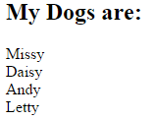
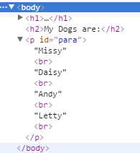
Methods of document interface - to loop through array createElement(), createTextNode(), appendChild()
var myPara = document.getElementById('para');
// loop through the array
// create elements, nodes, append them
for (var i = 0; i < myArray.length; i++) {
var text = document.createTextNode(myArray[i]);
var br = document.createElement('br');
myPara.appendChild(text);
myPara.appendChild(br);
}

